Slide 1
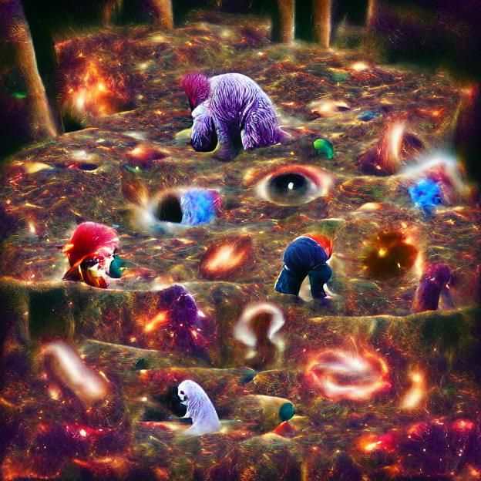
Phases of the Moon – Page 1
Imagine the moon loves playing dress-up. Every night, it chooses a new outfit. These outfits are its phases: new moon, waxing crescent, first quarter, waxing gibbous, full moon, waning gibbous, last quarter, and waning crescent. This fashion show isn’t just for fun, though. Sunlight shines on the moon differently each day, and our view from Earth changes. Depending on where the moon is in its orbit, we see more or less sunlight reflecting off its surface. This lunar fashion show gives us a different moon almost every night. Keep an eye on the sky and watch the moon's outfits change!
How did we describe the moon’s changing phases? ___________________________________________________________________
What are the ‘outfits’ or phases of the moon? ___________________________________________________________________
Why does the moon appear differently every night? ___________________________________________________________________
Imagine a cosmic game of hide and seek with the sun, moon, and Earth. The moon orbits Earth and plays this game. Sometimes, it's behind Earth, hidden in shadow. That's a new moon phase. Other times, it peeks out just a little, showing a crescent shape. As days pass, it reveals more, like a curtain slowly unveiling a surprise. The crescent grows bigger, heading towards a full moon. All these changes are due to the positions of the sun, moon, and Earth. Every position shows a different amount of the moon's illuminated part. It's nature's most intriguing hide and seek!
What game is being played in the cosmos? ___________________________________________________________________
How is the new moon phase described? ___________________________________________________________________
What happens after the crescent phase? ___________________________________________________________________

Slide 2
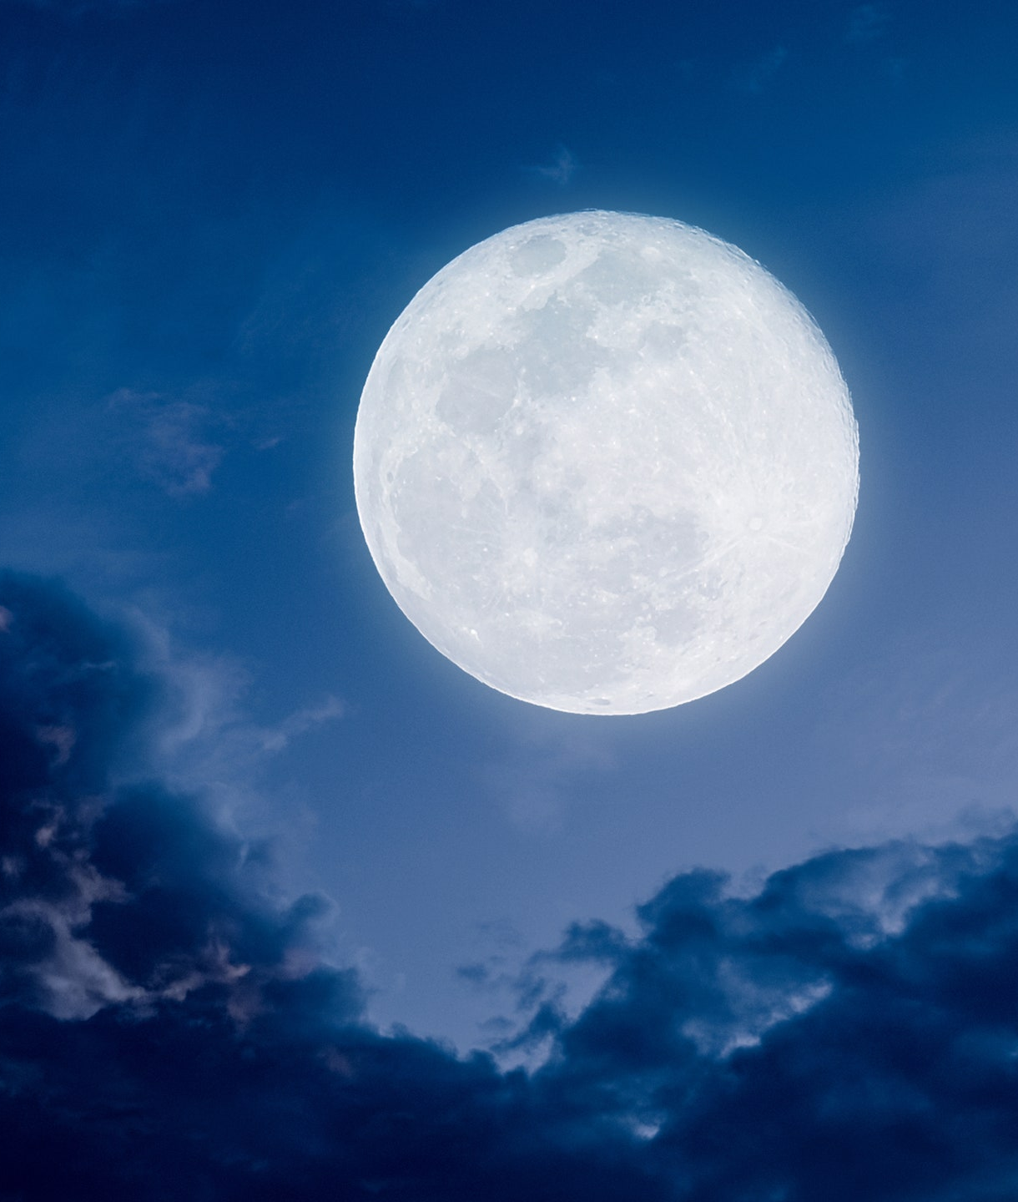
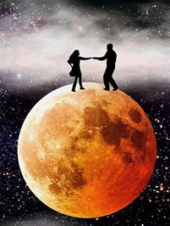
Phases of the Moon – Page 2
Every month, the moon hosts a grand show in the night sky called the full moon. On this special night, the moon appears big, round, and glowing. It shines so brightly because it's directly opposite the sun, reflecting all its light. This full moon phase can light up our nights, making them almost as bright as day. Have you ever noticed how clear everything looks during a full moon? Or how the sea sparkles under its light? This bright phase is just one of the many ways the moon communicates with us, showcasing its beauty and importance in our lives.
What is the moon’s grand show called? __________________________________________________________________
Why does the moon shine so brightly during this phase? __________________________________________________________________
What is special about the full moon’s position? __________________________________________________________________
In the cosmic dance between the new moon and the full moon, there’s a significant pause. It's the first quarter moon phase. At this time, half the moon is brightly lit, while the other half remains hidden. It's as if the moon is saying, "I'm halfway there!" As days continue, that bright half grows, inching towards the grand full moon. This progression is a captivating display of celestial rhythm. It's fascinating to think that as we go about our days, the moon is slowly changing, preparing for its next phase, always in sync with the sun and Earth.
What’s the pause between the new and full moon? __________________________________________________________________
How does the first quarter moon appear? __________________________________________________________________
What does the moon seem to indicate during this phase? __________________________________________________________________

